Slide 1
Systems of Equations and Inequalities
Precalculus: Chapter 8

Slide 2
This Slideshow was developed to accompany the textbook
Precalculus
By Richard Wright
https://www.andrews.edu/~rwright/Precalculus-RLW/Text/TOC.html
Some examples and diagrams are taken from the textbook.
Slides created by
Richard Wright, Andrews Academy
rwright@andrews.edu

Slide 3
8-01 Nonlinear and Linear Systems
In this section, you will:
Solve a system of equations by graphing.
Solve a system of equations by substitution.

Slide 4
8-01 Nonlinear and Linear Systems
System of Equations
Several equations with the same solution
Substitution
Solve one equation for a variable
Substitute this expression into the other equation
Solve the new equation
Substitute the solution back into the 1st equation and solve
Check your answers!

Slide 5
8-01 Nonlinear and Linear Systems
Solve $\left\{\begin{aligned}&−2x+y&=5 \\ x^{2}&+3x−y&=1\end{aligned}\right.$
Notes:
$$\left\{\begin{aligned}&−2x+y&=5 \\ x^{2}&+3x−y&=1\end{aligned}\right.$$
$$y=5+2x$$
$$x^{2}+3x−\left(5+2x\right)=1$$
$$x^{2}+x−5=1$$
$$x^{2}+x−6=0$$
$$\left(x−2\right)\left(x+3\right)=0$$
$$x−2=0 x+3=0$$
$$x=2 x=−3$$
X=2
$$y=5+2\left(2\right)=9$$
X=3
$$y=5+2\left(−3\right)=−1$$
$$\left(2, 9\right), (−3, −1)$$

Slide 6
8-01 Nonlinear and Linear Systems
Graphical Method
Graph both equations on same coordinate plane
The points of intersection are the solutions.

Slide 7
8-01 Nonlinear and Linear Systems
Solve graphically
$\left\{\begin{aligned}x^{2}−y&=5 \\ −x+y&=−3\end{aligned}\right.$
Notes:
Make both equations equal to y
$$\left\{\begin{aligned}y=x^{2}−5 \\ y=x−3\end{aligned}\right.$$
Graph
(−1, −4), (2, −1)

Slide 8
8-02 Two-Variable Linear Systems
In this section, you will:
Solve two-variable linear systems using elimination.
Classify types of solutions.

Slide 9
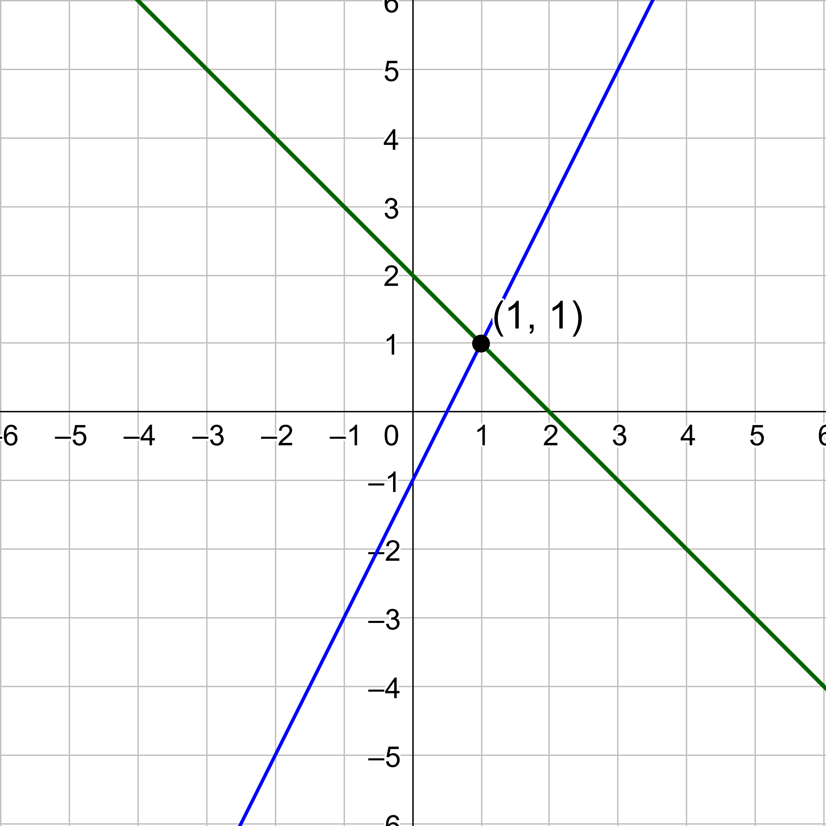
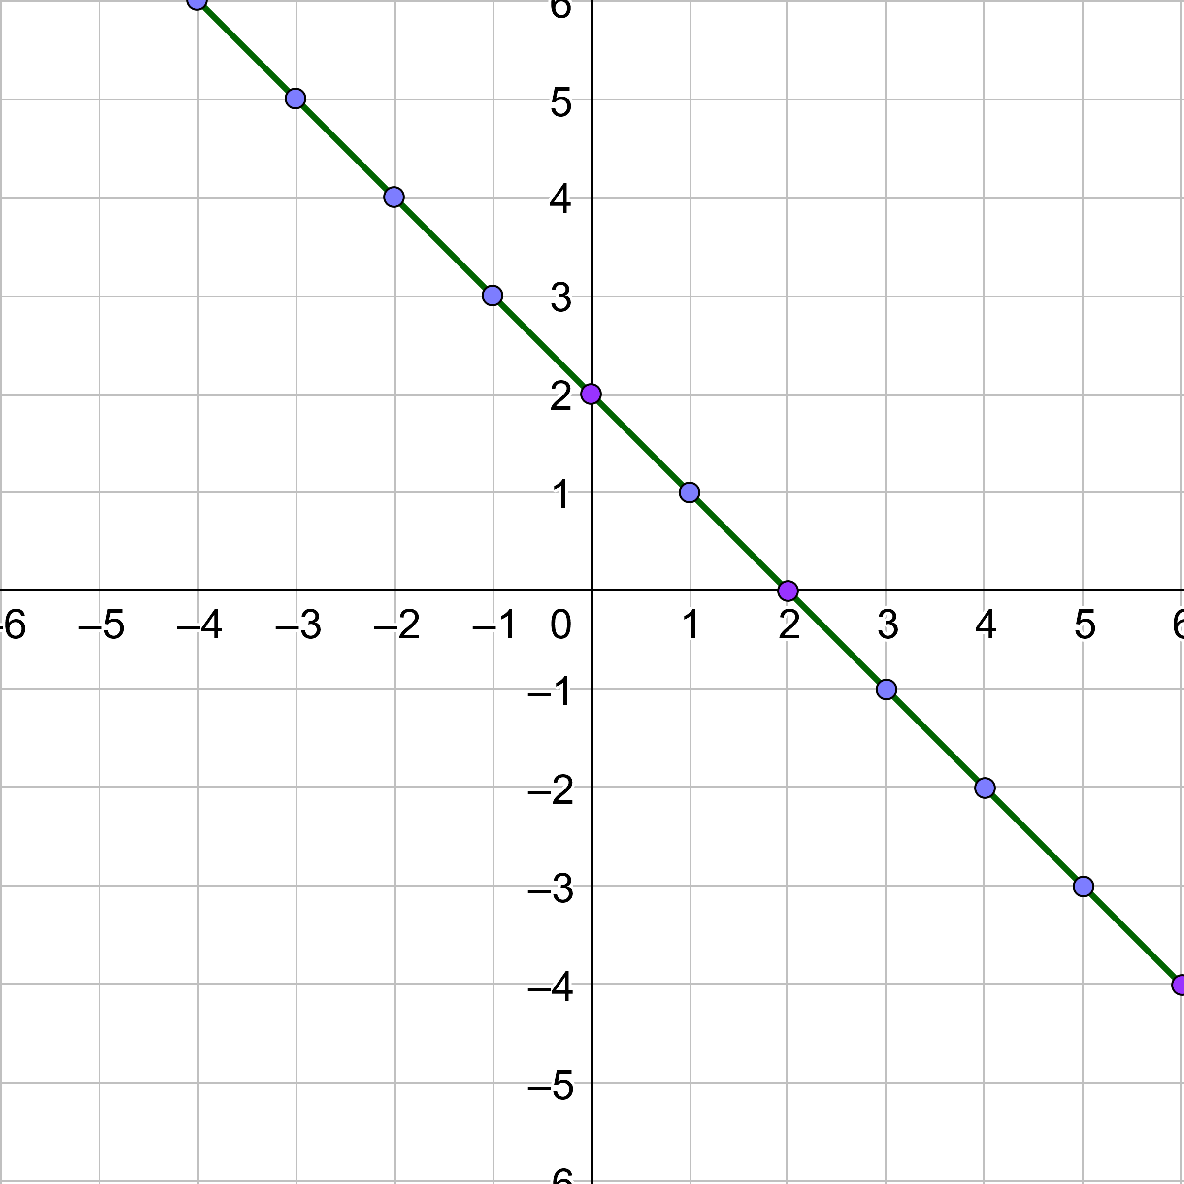
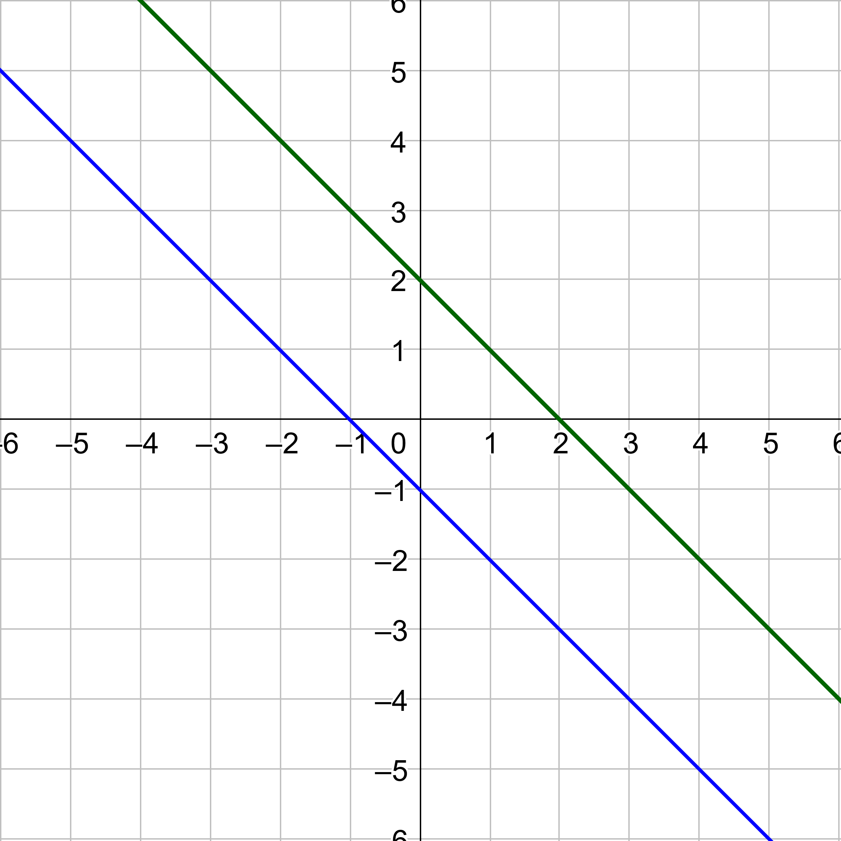
8-02 Two-Variable Linear Systems
Three possibilities for solutions
1 Solution: Consistent and Independent
Infinitely Many Solutions: Consistent and Dependent
No Solution: Inconsistent

Slide 10
8-02 Two-Variable Linear Systems
Solving Linear Equations by Elimination
Write the equations in columns (ax + by = c)
Obtain coefficients of one variable that differ only in sign by multiplying the equations by constants.
Add the equations and solve the resulting equation. (A variable will be eliminated.)
Back-substitute the answer into either original equation and solve.
Check your solution.

Slide 11
8-02 Two-Variable Linear Systems
If all the variables are eliminated and the result is
True (like 0 = 0), there are infinitely many solutions
False (like 0 = 9), there are no solutions

Slide 12
8-02 Two-Variable Linear Systems
Solve $\left\{\begin{aligned}4x+y&=−3 \\ x−3y&=9\end{aligned}\right.$
Notes:
$$\left\{\begin{aligned}4x+y=−3 \\ x−3y=9\end{aligned}\right.$$
$$\begin{aligned}12x+3y=−9 \\ x−3y=9\end{aligned}$$
$$13x=0$$
$$x=0$$
$$4\left(0\right)+y=−3$$
$$y=−3$$
(0, -3)

Slide 13
8-03 Multivariable Linear Systems
In this section, you will:
Use elementary row operations.
Solve systems of linear equations by putting them in row-echelon form.
Write the answer to a three-variable system of equations with many solutions.

Slide 14
8-03 Multivariable Linear Systems
Row-Echelon Form
The first nonzero term in each equation has a coefficient of 1.
All terms under the leading 1 are zero producing an inverted pyramid shape.
Any equations that are all zeros are at the bottom.
$\left\{\begin{aligned}1x+y+3z&=3 \\ 1y+5z&=10 \\ 1z&=7\end{aligned}\right.$

Slide 15
8-03 Multivariable Linear Systems
Elementary Row Operations
The following operations are allowed in systems of equations and produce equivalent systems.
Interchange two equations
Multiply one equation by a nonzero constant
Add a multiple of one equation to another equation and replace the latter equation

Slide 16
8-03 Multivariable Linear Systems
Solve $\left\{\begin{aligned}x&+y&+z&=3 \\ 2x&−y&+3z&=16 \\ x&−2y&−z&=1\end{aligned}\right.$
Notes:
$$\begin{aligned}−2 \\ \\ \end{aligned}\left\{\begin{aligned}x+y+z=3 \\ 2x−y+3z=16 \\ x−2y−z=1\end{aligned}\right.$$
$$\begin{aligned}−1 \\ \\ \end{aligned}\left\{\begin{aligned}x+y+z=3 \\ −3y+z=10 \\ x−2y−z=1\end{aligned}\right.$$
$$\begin{aligned} \\ −1 \\ \end{aligned}\left\{\begin{aligned}x+y+z=3 \\ −3y+z=10 \\ −3y−2z=−2\end{aligned}\right.$$
$$\begin{aligned} \\ −1/3 \\ −1/3\end{aligned}\left\{\begin{aligned}x+y+z=3 \\ −3y+z=10 \\ −3z=−12\end{aligned}\right.$$
$$\left\{\begin{aligned}x+y+z=3 \\ y−\frac{1}{3z}=−\frac{10}{3} \\ z=4\end{aligned}\right.$$
$$y=−\frac{10}{3}+\frac{1}{3}\left(4\right)=−2$$
$$x=3−\left(−2\right)−4=1$$
(1, -2, 4)

Slide 17
8-03 Multivariable Linear Systems
Solve $\left\{\begin{aligned}x&+2y&−7z&=−4 \\ 2x&+3y&+z&=5 \\ 3x&+7y&−36z&=−25\end{aligned}\right.$
Notes:
$$\begin{aligned}−2 \\ \\ \end{aligned}\left\{\begin{aligned}x+2y−7z=−4 \\ 2x+3y+z=5 \\ 3x+7y−36z=−25\end{aligned}\right.$$
$$\begin{aligned}−3 \\ \\ \end{aligned}\left\{\begin{aligned}x+2y−7z=−4 \\ −y+15z=13 \\ 3x+7y−36z=−25\end{aligned}\right.$$
$$\left\{\begin{aligned}x+2y−7z=−4 \\ −y+15z=13 \\ y−15z=−13\end{aligned}\right.$$
$$\begin{aligned} \\ −1 \\ \end{aligned}\left\{\begin{aligned}x+2y−7z=−4 \\ −y+15z=13 \\ 0=0\end{aligned}\right.$$
Many solutions
Let z=a
$$y=15z−13$$
$$y=15a−13$$
$$x+2\left(15a−13\right)−7a=−4$$
$$x+30a−26−7a=−4$$
$$x=−23z+22$$
(-23a+22, 15a-13, a)

Slide 18
8-03 Multivariable Linear Systems
Solve $\left\{\begin{aligned}x−y+4z=3 \\ 4x−z=0\end{aligned}\right.$
Notes:
$$\begin{aligned}−4 \\ \end{aligned}\left\{\begin{aligned}x−y+4z=3 \\ −z=0\end{aligned}\right.$$
$$\begin{aligned} \\ 1/4\end{aligned}\left\{\begin{aligned}x−y+4z=3 \\ 4y−17z=−12\end{aligned}\right.$$
$$\left\{\begin{aligned}x−y+4z=3 \\ y−\frac{17}{4}z=−3\end{aligned}\right.$$
Let z=4a (so no fractions)
$$y−\frac{17}{4}\left(4a\right)=−3$$
$$y=17a−3$$
$$x−\left(17a−3\right)+4\left(4a\right)=3$$
$$x−17a+3+16a=3$$
$$x=a$$
(a, 17a-3, 4a)

Slide 19
8-04 Partial Fractions
In this section, you will:
Decompose rational expressions into partial fractions with:
Distinct linear factors
Repeated linear factors
Distinct quadratic factors
Repeated quadratic factors

Slide 20
8-04 Partial Fractions
To split a rational function into smaller fractions
Like $\frac{5}{12}=\frac{1}{6}+\frac{1}{4}$
$\frac{x+8}{x^{2}+6x+8}=\frac{?}{x+2}+\frac{?}{x+4}$

Slide 21
8-04 Partial Fractions
To Find Partial Fractions
Factor the denominator.
For each linear factor of the denominator are in the form $\frac{A}{px+q}+\frac{B}{{\left(px+q\right)}^{2}}+⋯$
For each quadratic factor of the denominator are in the form $\frac{Ax+B}{ax^{2}+bx+c}+\frac{Cx+D}{{\left(ax^{2}+bx+c\right)}^{2}}+⋯$
Solve for A, B, C, etc.
Multiply by the LCD
Choose convenient values of x to find A, B, C, etc.
Or create a system of linear equations based on the coefficients of x.

Slide 22
8-04 Partial Fractions
Find the partial fractions $\frac{x+8}{x^{2}+6x+8}=$
Notes:
$$\frac{x+8}{(x+2)(x+4)}=\frac{A}{x+2}+\frac{B}{x+4}$$
Multiply by LCD
$$x+8=A\left(x+4\right)+B\left(x+2\right)$$
Shortcut: Use convenient x-values
Let x=-2: $−2+8=A\left(−2+4\right)+B\left(−2+2\right)$
$$6=2A$$
$$A=3$$
Let x=-4: $−4+8=A\left(−4+4\right)+B\left(−4+2\right)$
$$4=−2B$$
$$B=−2$$
$$\frac{3}{x+2}−\frac{2}{x+4}$$

Slide 23
8-04 Partial Fractions
$\frac{3x^{2}−x+5}{x^{3}−2x^{2}+x}$
Notes:
$$\frac{3x^{2}−x+5}{x(x−1)(x−1)}=\frac{A}{x}+\frac{B}{x−1}+\frac{C}{{\left(x−1\right)}^{2}}$$
Multiply by LCD
$$3x^{2}−x+5=A{\left(x−1\right)}^{2}+Bx\left(x−1\right)+Cx$$
Convenient values don’t work. Multiply out and combine like terms of x.
$$3x^{2}−x+5=Ax^{2}−2Ax+A+Bx^{2}−Bx+Cx$$
$$3x^{2}−x+5=\left(A+b\right)x^{2}+\left(−2A−B+C\right)x+A$$
Make equations out of like terms of x.
$$\left\{\begin{aligned}A+B=3 \\ −2A−B+C=−1 \\ A=5\end{aligned}\right.$$
Top equation
$$5+B=3$$
$$B=−2$$
Middle equation
$$−2\left(5\right)−\left(−2\right)+C=1$$
$$C=7$$
$$\frac{5}{x}+\frac{−2}{x−1}+\frac{7}{{\left(x−1\right)}^{2}}$$

Slide 24
8-04 Partial Fractions
$\frac{6x^{3}+16x}{{\left(x^{2}+3\right)}^{2}}$
Notes:
$$\frac{6x^{3}+16x}{{\left(x^{2}+3\right)}^{2}}=\frac{Ax+B}{x^{2}+3}+\frac{Cx+D}{{\left(x^{2}+3\right)}^{2}}$$
Multiply by LCD
$$6x^{3}+16x=\left(Ax+B\right)\left(x^{2}+3\right)+\left(Cx+D\right)$$
Convenient values don’t work, so multiply out and gather like terms of x
$$6x^{3}+16x=Ax^{3}+Bx^{2}+3Ax+3B+Cx+D$$
$$6x^{3}+16x=Ax^{3}+Bx^{2}+\left(3A+C\right)x+\left(3B+D\right)$$
Make equations out of the like terms.
$$\left\{\begin{aligned}A=6 \\ B=0 \\ 3A+C=16 \\ 3B+D=0\end{aligned}\right.$$
Third equation
$$3\left(6\right)+C=16$$
$$C=−2$$
Fourth equation
$$3\left(0\right)+D=0$$
$$D=0$$
$$\frac{6x}{x^{2}+3}+\frac{−2x}{{\left(x^{2}+3\right)}^{2}}$$

Slide 25
8-05 Systems of Inequalities
In this section, you will:
Graph systems of equations.
Find the vertices of a graph of a system of equations.

Slide 26
8-05 Systems of Inequalities
Solve Systems of Inequalities
Graph all the inequalities on the same coordinate plane.
Find the intersection of the shaded areas.

Slide 27
8-05 Systems of Inequalities
Graph an Inequality
Pretend the inequality sign is = and graph the line.
Decide if the line is solid or dotted
Solid if ≤, =, or ≥
Dotted if < or >
Shade
Pick a test point not on the line.
Plug the test point into the inequality
If this results in a true statement, then shade the side of the graph with the test point.
If the result is not a true statement, then shade the other side of the graph.
OR if solved for y
y > shade above the line.
y < shade below the line.

Slide 28
8-05 Systems of Inequalities
Solve $\left\{\begin{aligned}x+y≥1 \\ −x+y≥1 \\ y≤2\end{aligned}\right.$

Slide 29
8-05 Systems of Inequalities
Solve $\left\{\begin{aligned}y≥x^{2} \\ y>x+2\end{aligned}\right.$

Slide 30
8-06 Linear Programming
In this section, you will:
Use linear programming to maximize or minimize a function.

Slide 31
8-06 Linear Programming
Optimization strategy
Maximize or minimize
Objective function to optimize
Constraints – system of inequalities
Graph constraints and find vertices of solution
Max or min will be at vertex
Plug vertices into objective function to find min or max

Slide 32
8-06 Linear Programming
Find the minimum value of $z=4x+6y$ subject to $\left\{\begin{aligned}x≥0 \\ y≥0 \\ x+y≥2 \\ y≤4 \\ x≤5\end{aligned}\right.$
Notes:
Test vertices
(2, 0): $z=4\left(2\right)+6\left(0\right)=8$
(5, 0): $z=4\left(5\right)+6\left(0\right)=20$
(5, 4): $z=4\left(5\right)+6\left(4\right)=44$
(0, 4): $z=4\left(0\right)+6\left(4\right)=24$
(0, 2): $z=4\left(0\right)+6\left(2\right)=12$
Minimum is 8 at (2, 0)

